Slide 1


District Counselor Meeting
December 5, 2024

Slide 2


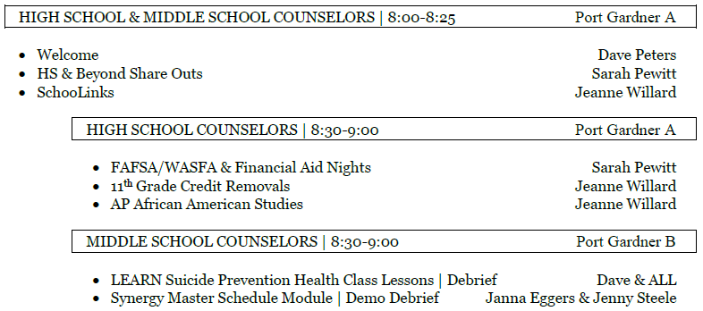
Today’s Agenda

Slide 3


HS & Beyond | Share-Outs

Slide 4



FAFSA/WASFA

Slide 5
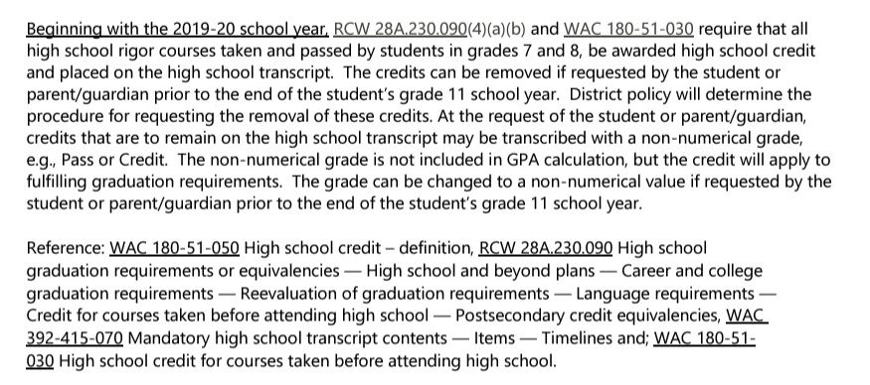
MS Courses → HS Transcripts

Slide 6

AP African American Studies
New for 2025-26
U.S. History Option
Recruit Students
  AP African American StudiesAP Central | College Board: Main Course Webpage
  AP African American Studies Course and Exam Description
  AP® African American Studies Course at a Glance
  Classroom Resources – AP Central | College Board

Slide 7


Happy Holidays!

